Slide 1
CS 110 - Professional Practices in IT Instructor Name : Dr Tariq Umer Email : tariqumer@cuilahore.edu.pk

Slide 2
Lecture - 6 CYBER CRIME LAWS IN PAKISTAN

Slide 3
What We Will Cover
Cyber Crime Globally
Evolution of Cyber Crime Laws in Pakistan
Important Cyber Laws and cases

Slide 4
Cyber Crime Globally

Slide 5
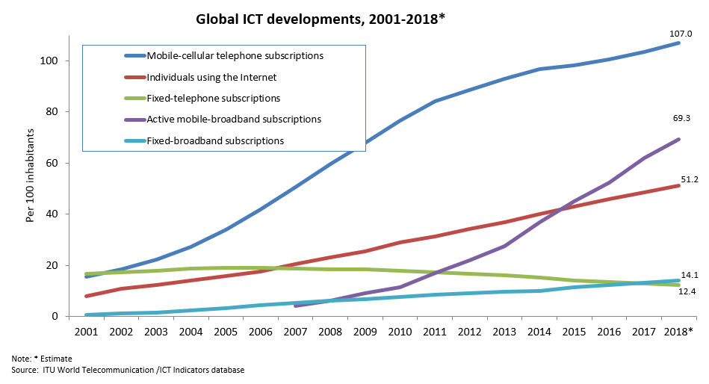

Slide 6
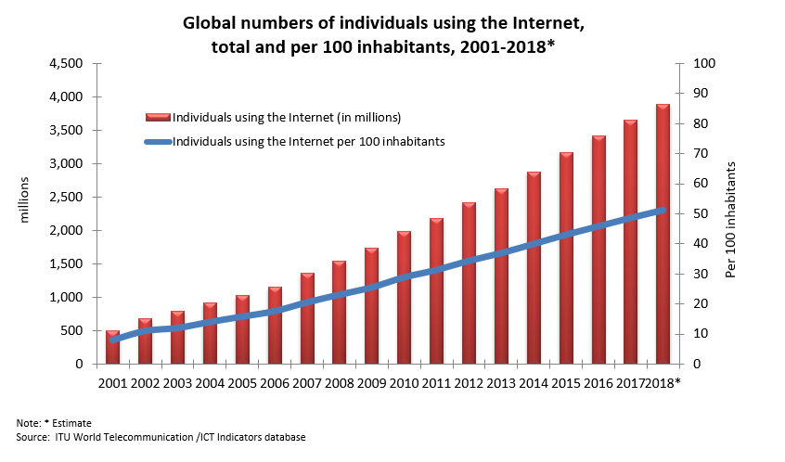

Slide 7
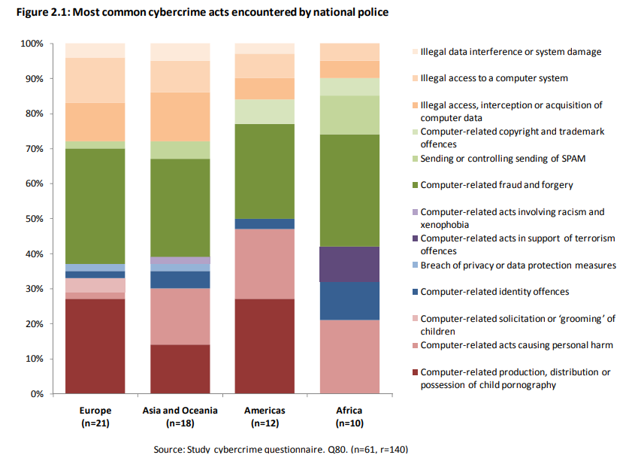
https://www.unodc.org/documents/organized-crime/UNODC_CCPCJ_EG.4_2013/CYBERCRIME_STUDY_210213.pdf

Slide 8
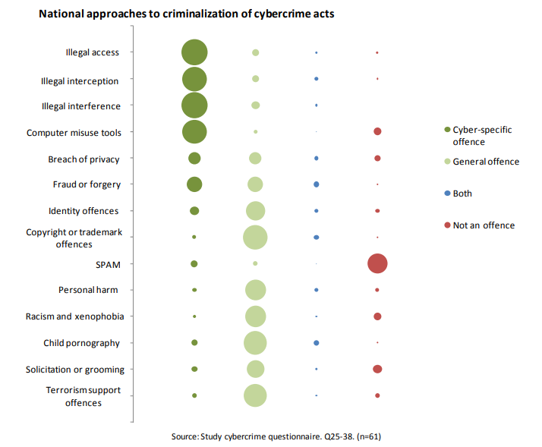
https://www.unodc.org/documents/organized-crime/UNODC_CCPCJ_EG.4_2013/CYBERCRIME_STUDY_210213.pdf

Slide 9
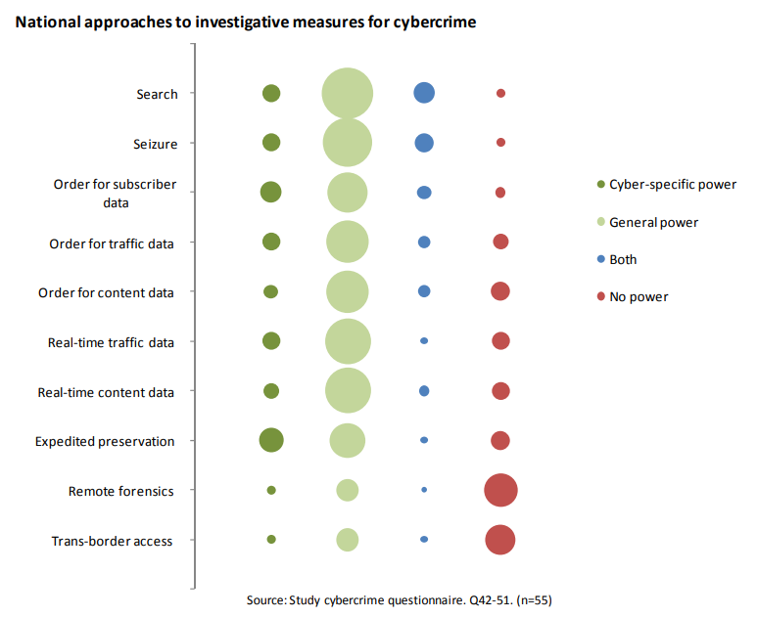
https://www.unodc.org/documents/organized-crime/UNODC_CCPCJ_EG.4_2013/CYBERCRIME_STUDY_210213.pdf

Slide 10
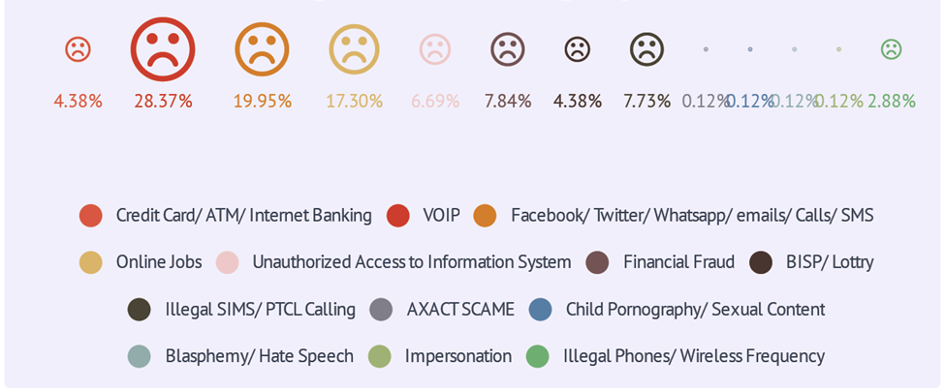
FIR/Cases Registered Category wise by NR3C in 2016

Slide 11
https://www.dawn.com/news/1440854

Slide 12
Blasphemous/Obscene Content
1 | Blocked URLs with blasphemous material by PTA | 50,000
2 | Total Blocked URLs (Mostly Porn Sites) | 850,000
1 | Dailymotion URLs Blocked | 230
2 | Facebook URLs Blocked | 15,800
3 | YouTube URLs Blocked | 6,624
4 | Other Platforms | 22,000

Slide 13
Evolution of Cyber Crime Laws in Pakistan (1985-2019)

Slide 14
ELECTRONIC CRIME LAWS
The Telegraph Act
The Wireless Receiving Apparatus (Licensing) Rules
The Wireless Telegraphy Act
1885
1957
1957
1974
1993
1996
2002
The Wireless Telegraphy (Possession) Rules
The Federal Investigation Agency Act - 1974
The Pakistan Telecommunication Act - 1996
The Accredited Certification Service Provider's Audit Regulations
The Certification Council Transaction of Business Regulations
The electronic Transaction Ordinance
2008
2008
2004
2002
1885-2016
2008
The Certification Service Providers' Accreditation Regulations
The Federal Investigation Agency Rules
The Protection from Spam, Unsolicited Fraudulent and Obnoxious Communication Regulations
The Investigation for Fair Trial Rules
The Information Security Auditors Registration Regulations
2009
2013
2013
2015
2016
The Investigation for Fair Trial Act
Subscribers Antecedents Verification Regulations
The Prevention of Electronic Crimes Act

Slide 15
Definitions

Slide 16
Message
PECA 2016 | Not Defined in Definition Section (information and data are used)
ETO 2002 | Not Defined in Definition Section (information is used)
The Pakistan Telecommunication (Re-Organization) Act – 1996 | Not Defined in Definition Section (intelligence is used)
The Wireless Telegraphy Act, 1933 | Not Defined in Definition Section
The Telegraph Act, 1885 | “message” means any communication, whether in written, printed, pictorial or spoken form, transmitted, emitted, made, received or delivered by telegraph or given to a telegraph officer to be transmitted or emitted, and includes all contents thereof;

Slide 17
Intelligence
PECA 2016 | Not Defined in Definition Section (information and data are used)
ETO 2002 | Not Defined in Definition Section (information is used)
The Pakistan Telecommunication (Re-Organization) Act – 1996 | means any speech sound, data, signal, writing image or video
The Wireless Telegraphy Act, 1933 | Not Defined in Definition Section
The Telegraph Act, 1885 | Not Defined in Definition Section

Slide 18
Information
PECA 2016 | includes text, message, data, voice, sound, database, video, signals, software, computer programs, any forms of intelligence as defined under the Pakistan Telecommunication (Reorganization) Act, 1996 (XVII of 1996) and codes including object code and source code;
ETO 2002 | includes text, message, data, voice, sound, database, video, Signals, software,computer programs, codes including object code and source code;
The Pakistan Telecommunication (Re-Organization) Act – 1996 | Not Defined in Definition Section (intelligence is used)
The Wireless Telegraphy Act, 1933 | Not Defined in Definition Section
The Telegraph Act, 1885 | Not Defined in Definition Section

Slide 19
Data
PECA 2016 | “data” includes content data and traffic data; "content data" means any representation of fact, information or concept for processing in an information system including source code or a program suitable to cause an information system to perform a function; "traffic data" includes data relating to a communication indicating its origin, destination, route, time, size, duration or type of service;
ETO 2002 | Not Defined in Definition Section (information is used)
The Pakistan Telecommunication (Re-Organization) Act – 1996 | Not Defined in Definition Section (intelligence is used)
The Wireless Telegraphy Act, 1933 | Not Defined in Definition Section (message is used)
The Telegraph Act, 1885 | Not Defined in Definition Section (message is used)

Slide 20
Information Systems
PECA 2016 | means an electronic system for creating, generating, sending, receiving,storing, reproducing, displaying, recording or processing any information;
ETO 2002 | means an electronic system for creating, generating, sending, receiving, storing, reproducing, displaying, recording or processing information;
The Pakistan Telecommunication (Re-Organization) Act – 1996 | Not Defined in Definition Section (“terminal equipment”) is used
The Wireless Telegraphy Act, 1933 | Not Defined in Definition Section (“wireless telegraphy apparatus”) is used
The Telegraph Act, 1885 | Not Defined in Definition Section (“telegraph”) is used

Slide 21
Electronic
PECA 2016 | includes electrical, digital, magnetic, optical, biometric, electrochemical, electromechanical, wireless or electromagnetic technology;
ETO 2002 | includes electrical, digital, magnetic, optical, biometric, electro­chemical, wireless or electromagnetic technology:
The Pakistan Telecommunication (Re-Organization) Act – 1996 | includes electrical, digital, magnetic, optical, biometric, electro­chemical, wireless or electromagnetic technology:
The Wireless Telegraphy Act, 1933 | Not Defined in Definition Section
The Telegraph Act, 1885 | Not Defined in Definition Section

Slide 22
Cognizable Offence
Cognizable | Offence is one in which the police is authorized to take cognizance (notice) of the crime at its own. Police officer has the authority to make an arrest without a warrant and to start an investigation with or without the permission of a court. The police can file a First Information Report (FIR) only for cognizable offences. More serious than the non cognizable cases. Normally, serious offences are defined as cognizable and usually carry a sentence of 3 years or more

Slide 23
Non-Cognizable Offence
Non-Cognizable | Offences in which the police has no authority to apprehend a person for crime on its own. Arrest. Without warrant. Offences includes misbehavior, public annoyance etc. In general non-cognizable offences are billable.

Slide 24
Compoundable
Compoundable | A compromise between parties can be reached even after the FIR is recorded. The offender is acquitted after the compromise is made. This includes Qisas and Diyat laws.

Slide 25
Non Compoundable
Non-Compoundable | No compromise can be made between the parties, thus the offender has to suffer his punishment. This includes offences against state or which involve revolt against the government and terrorist attacks fasaad fil arz

Slide 26
PECA 2016 - Offences
Unauthorized Access/ Copying/ Transmission or Interference with IS or Data
3. Unauthorized **access** to information system or data
4. Unauthorized **copying** or transmission of data
5. **Interference** with information system or data
6. Unauthorized **access** to critical infrastructure information system or data
7. Unauthorized **copying** or transmission of critical infrastructure data
8. **Interference** with critical infrastructure information system or data
Techniques of Deception
13. Electronic forgery
14. Electronic fraud
25. Spamming
26. Spoofing
16. Unauthorized use of identity information
Advance Technical Techniques
15. Making, obtaining, or supplying device for use in offence
18. Tampering, etc. of communication equipment
17. Unauthorized issuance of SIM cards etc
19. Unauthorized interception
23. Malicious code
Crimes against Individuals
20. Offences against dignity of a natural person
21. Offences against modesty of a natural person and minor
22. Child Pornography
24. Cyber Stalking
Crimes against a Group/ Sect/ Community/ Nation
9. Glorification of an offence
10. Cyber terrorism
11. Hate speech
12. Recruitment, funding and planning of terrorism

Slide 27
Unauthorized access to information system or data (PECA 2016-Section 03)
Whoever with dishonest intention gains unauthorized access to any information system or data shall be punished with imprisonment for a term which may extend to three months or with fine which may extend to fifty thousand rupees or with both.
Type of Offence:
Non Cognizable
Bailable
Compoundable
Punishment
Max Prison – 3 Months or
Fine of Max – 50,000/= or
Both

Slide 28
Unauthorized copying or transmission of data (PECA 2016-Section 04)
Whoever with dishonest intention and without authorization copies or otherwise transmits or causes to be transmitted any data shall be punished with imprisonment for a term which may extend to six months, or with fine which may extend to one hundred thousand rupees or with both.
Type of Offence:
Non Cognizable
Bailable
Compoundable
Punishment
Max Prison – 6 Months or
Fine of Max – 100,000/= or
Both

Slide 29
Interference with information system or data (PECA 2016-Section 05)
Whoever with dishonest intention interferes with or damages or causes to be interfered with or damages any part or whole of an information system or data shall be punished with imprisonment which may extend to two years or with fine which may extend to five hundred thousand rupees or with both.
Type of Offence:
Non Cognizable
Bailable
Compoundable
Punishment
Max Prison – 2 Years or
Fine of Max – 500,000/= or
Both

Slide 30

Case: Unauthorized access to information system or data
FIR No. 02/2018, under Section 3/4/5/6/7/10(a)/13/14 of PECA 2016 read with Section 420/467/468/471/109 PPC registered at P.S. FIA, Cyber Crime Circle, Karachi
Manager Al Baraka Bank complained regarding fraudulent withdrawal of cash from ATM machine of their bank branch at DHA Karachi; on basis of CCTV footage one of the Chinese individual was found involved; police arrested the accused persons namely Liu Liming – Zhu Yu Ping and Zeng Chun Yu and handed their custody to FIA along with Memo of Arrest, Recovery, Personal Search U/s. 54/550 Cr.PC prepared on the spot for proper enquiry; during the course of enquiry it has been transpired that accused persons are Chinese nationals and on questioning regarding committed crime of withdrawal of amount fraudulent /deceitfully from ATM of Al-Barakah Bank DHA Karachi, admitted guilt and recovery of huge amount of Rs.22,80,000/- and 355 ATM cards including incriminating material/items were effected from their possession.

Slide 31
Case: Unauthorized access to information system or data
During interrogation the accused persons disclosed that the mastermind of the committed crime is one of their Chinese national namely Weiming @ Lan, who brought them to Pakistan for such illegal act, in this way the accused persons above named alongwith absconding accused Weiming @ Lan were busy in withdrawal of transaction through recovered ATMs were intercepted and caught red handed ATM of Al-Barakah Bank DHA, Karachi, hence case was registered against accused persons punishable under Section 3, 4, 5, 13, 14 PECA R/w 420/467/468/471/109 PPC.
Attorney General for Pakistan contends that this is a unique case whereby the present applicant along with co-accused paralyzed the banking system and recovery of Rs.22,80,000/- along with 355 ATM Cards was effected, hence, applicant is not entitled for bail.

Slide 32
Unauthorized access to critical infrastructure information system or data (PECA 2016- Section 06)
Whoever with dishonest intention gains unauthorized access to any critical infrastructure information system or data shall be punished with imprisonment which may extend to three years or with fine which may extend to one million rupees or with both.
Type of Offence:
Non Cognizable
Bailable
Compoundable
Punishment
Max Prison – 3 -5 years or
Fine of Max – 1000,000/= or
Both

Slide 33
Unauthorized copying or transmission of critical infrastructure data (PECA 2016-Section 07)
Whoever with dishonest intention and without authorization copies or otherwise transmits or causes to be transmitted any critical infrastructure data shall be punished with imprisonment for a term which may extend to five years, or with fine which may extend to five million rupees or with both.
Type of Offence:
Non Cognizable
Bailable
Compoundable
Punishment
Max Prison – 5 Years or
Fine of Max – 5 Million or
Both

Slide 34
Interference with critical infrastructure information system or data (PECA 2016-Section 08)
Whoever with dishonest intention interferes with or damages, or causes to be interfered with or damaged, any part or whole of a critical infrastructure information system or data , shall be punished with imprisonment which may extend to seven years or with fine which may extend to ten million rupees or with both.
Type of Offence:
Non Cognizable
Bailable
Compoundable
Punishment
Max Prison – 7 Years or
Fine of Max – 10 Million or
Both

Slide 35
Glorification of an offence (PECA 2016-Section 09)
(1) Whoever prepares or disseminates information, through any information system or device, with the intent to glorify an offence relating to terrorism, or any person convicted of a crime relating to terrorism, or activities of proscribed organizations or individuals or groups shall be punished with imprisonment for a term which may extend to seven years or with fine which may extend to ten million rupees or with both.
Explanation.—For the purposes of this section "glorification" includes depiction of any form of praise or celebration in a desirable manner.
Type of Offence:
Cognizable
Bailable
Compoundable
Punishment
Max Prison – 7 Years or
Fine of Max – 10 Million or
Both

Slide 36
Cyber terrorism (PECA2016-Section 10)
Whoever commits or threatens to commit any of the offences under sections 6, 7, 8 or 9, where the commission or threat is with the intent to,—
coerce, intimidate, create a sense of fear, panic or insecurity in the Government or the public or a section of the public or community or sect or create a sense of fear or insecurity in society; or
advance inter-faith, sectarian or ethnic hatred; or
advance the objectives of organizations or individuals or groups proscribed under the law, shall be punished with imprisonment of either description for a term which may extend to fourteen years or with fine which may extend to fifty million rupees or with both.
Type of Offence:
Cognizable
Non-Bailable
Non-Compoundable
Punishment
Max Prison – 7 Years or
Fine of Max – 10 Million or
Both

Slide 37
Accused commits offences under sections 6, 7, 8 or 9, where the commission or threat is with the intent to
Unauthorized access to critical infrastructure information system or data - Section 06
Unauthorized copying or transmission of critical infrastructure data - Section 07
Interference with critical infrastructure information system or data - Section 08
Glorification of an offence - Section 09
Intention was to glorify an offence related to terrorism or any person convicted of crime related to terrorism or activities of band organizations or individual or groups
Notes:
Accused commits offences under sections 6, 7, 8 or 9, where the commission or threat is with the intent to
Unauthorized access to critical infrastructure information system or data - Section 06
Unauthorized copying or transmission of critical infrastructure data - Section 07
Interference with critical infrastructure information system or data - Section 08
Glorification of an offence - Section 09
Intention was to glorify an offence related to terrorism or any person convicted of crime related to terrorism or activities of band organizations or individual or groups

Slide 38
Hate speech (PECA2016-Section 11)
Whoever prepares or disseminates information, through any information system or device, that advances or is likely to advance interfaith, sectarian or racial hatred, shall be punished with imprisonment for a term which may extend to seven years or with fine or with both.
Type of Offence:
Non-Cognizable
Bailable
Compoundable
Punishment
Max Prison – 7 Years or
Fine of Max – Any or
Both

Slide 39
Recruitment, funding and planning of terrorism (PECA2016-Section 12)
Whoever prepares or disseminates information, through any information system or device, that invites or motivates to fund, or recruits people for terrorism or plans for terrorism shall be punished with imprisonment for a term which may extend to seven years or with fine or with both.
Type of Offence:
Non-Cognizable
Bailable
Compoundable
Punishment
Max Prison – 7 Years or
Fine of Max – Any or
Both

Slide 40
Electronic forgery (PECA 2016 – Section13)
(1) Whoever interferes with or uses any information system, device or data, with the intent to cause damage or injury to the public or to any person, or to make any illegal claim or title or to cause any person to part with property or to enter into any express or implied contract, or with intent to commit fraud by any input, alteration, deletion, or suppression of data, resulting in unauthentic data with the intent that it be considered or acted upon for legal purposes as if it were authentic, regardless of the fact that the data is directly readable and intelligible or not, shall be punished with imprisonment of either description for a term which may extend to three years, or with fine which may extend to two hundred and fifty thousand rupees or with both.
(2) Whoever commits offence under sub-section (1) in relation to a critical infrastructure information system or data shall be punished with imprisonment for a term which may extend to seven years or with fine which may extend to five million rupees or with both.

Slide 41
Accused interfered with or used any information system, device or data; or
Accused with the intention to commit fraud by any input, alteration, deletion or suppression of data which resulted in unauthentic data; and
That the accused made any illegal claim or title or caused any person to part with property or enter into any express or implied contract; and
Accused did so with intent to cause damage or injury to the public or to any person; or
That the intention of accused was that it be considered or acted upon for legal purpose as if it were authentic
Type of Offence:
Non-Cognizable
Bailable
Compoundable
Punishment
Max Prison – 3 Years or
Fine of Max – 250,000/= Any or
Both

Slide 42
Electronic fraud (PECA 2016 – Section 14)
Whoever with the intent for wrongful gain interferes with or uses any information system, device or data or induces any person to enter into a relationship or deceives any person, which act or omission is likely to cause damage or harm to that person or any other person shall be punished with imprisonment for a term which may extend to two years or with fine which may extend to ten million rupees or with both.
Type of Offence:
Non-Cognizable
Bailable
Compoundable
Punishment
Max Prison – 2 Years or
Fine of Max – 10 Million/= Any or
Both

Slide 43
Making, obtaining, or supplying device for use in offence(PECA 2016 – Section 15)
Whoever produces, makes, generates, adapts, exports, supplies, offers to supply or imports for use any information system, data or device, with the intent to be used or believing that it is primarily to be used to commit or to assist in the commission of an offence under this Act shall, without prejudice to any other liability that he may incur in this behalf, be punished with imprisonment for a term which may extend to six months or with fine which may extend to fifty thousand rupees or with both.
Type of Offence:
Non-Cognizable
Bailable
Compoundable
Punishment
Max Prison – 6 months or
Fine of Max – 50,000/= Any or
Both

Slide 44
Unauthorized use of identity information (PECA 2016 – Section 16)
(1) Whoever obtains, sells, possesses, transmits or uses another person's identity information without authorization shall be punished with imprisonment for a term which may extend to three years or with fine which may extend to five million rupees, or with both.
(2) Any person whose identity information is obtained, sold, possessed, used or transmitted may apply to the Authority for securing, destroying, blocking access or preventing transmission of identity information referred to in sub-section (1) and the Authority on receipt of such application may take such measures as deemed appropriate for securing, destroying or preventing transmission of such identity information.
Type of Offence:
Non-Cognizable
Bailable
Compoundable
Punishment
Max Prison – 3 Years or
Fine of Max 5 Million/= Any or
Both

Slide 45
Unauthorized issuance of SIM cards (PECA 2016 – Section 17)
Whoever sells or otherwise provides subscriber identity module (SIM) card, re-usable identification module (R-IUM) or universal integrated circuit card (UICC) or other module designed for authenticating users to establish connection with the network and to be used in cellular mobile, wireless phone or other digital devices such as tablets, without obtaining and verification of the subscriber's antecedents in the mode and manner for the time being approved by the Authority shall be punished with imprisonment for a term which may extend to three years or with fine which may extend to five hundred thousand rupees or with both.
Type of Offence:
Non-Cognizable (Cognizable on Complaint by Authority)
Bailable
Compoundable
Punishment
Max Prison – 3 Years or
Fine of Max – 500,000/= Any or
Both
https://www.pta.gov.pk/media/sub_ante_veri_reg_180511.pdf

Slide 46
Tampering, etc. of communication equipment (PECA 2016 – Section 18)
Whoever unlawfully or without authorization changes, alters, tampers with or re-programs unique device identifier of any communication equipment including a cellular or wireless handset and starts using or marketing such device for transmitting and receiving information shall be punished with imprisonment which may extend to three years or with fine which may extend to one million rupees or with both.
Explanation.—A "unique device identifier" is an electronic equipment identifier which is unique to a communication device.
Type of Offence:
Non-Cognizable
Bailable
Compoundable
Punishment
Max Prison – 3 Years or
Fine of Max – 1 Million/= Any or
Both

Slide 47
Unauthorized interception (PECA 2016 – Section 19)
Whoever with dishonest intention commits unauthorized interception by technical means of—
any transmission that is not intended to be and is not open to the public, from or within an information system; or
electromagnetic emissions from an information system that are carrying data, shall be punished with imprisonment of either description for a term which may extend to two years or with fine which may extend to five hundred thousand rupees or with both.
Type of Offence:
Non-Cognizable
Bailable
Compoundable
Punishment
Max Prison – 2 Years or
Fine of Max – 500,000/= Any or
Both

Slide 48
Accused committed unauthorized interception by technical means of
That accused did so with dishonest intentions
any transmission that is not intended to be and is not open to the public, from or within an information system; or
electromagnetic emissions from an information system that are carrying data

Slide 49
Offences against dignity of a natural person (PECA 2016 – Section 20)
Whoever intentionally and publicly exhibits or displays or transmits any information through any information system, which he knows to be false, and intimidates or harms the reputation or privacy of a natural person, shall be punished with imprisonment for a term which may extend to three years or with fine which may extend to one million rupees or with both:
Provided that nothing under this sub-section shall apply to anything aired by a broadcast media or distribution service licensed under the Pakistan Electronic Media Regulatory Authority Ordinance, 2002 (XIII of 2002).

Slide 50
Offences against dignity of a natural person (PECA 2016 – Section 20)
Any aggrieved person or his guardian, where such person is a minor, may apply to the Authority for removal, destruction of or blocking access to such information referred to in sub-section
and the Authority on receipt of such application, shall forthwith pass such orders as deemed reasonable in the circumstances including an order for removal, destruction, preventing transmission of or blocking access to such information and the Authority may also direct any of its licensees to secure such information including traffic data.
Type of Offence:
Non-Cognizable
Bailable
Compoundable
Punishment
Max Prison – 3 Years or
Fine of Max – 1 Million/= Any or
Both

Slide 51
Case File - Offences against dignity of a natural person
FIR No.77 dated 27-7-2017 with Police Station Cyber Crime Circle NR-IIIC, FIA Lahore under Sections 20, 21 & 24 of the Prevention of Electronic Crimes Act
Alleged that accused carried on with complainant’s wife and by taking advantage thereof, managed intimate stills as well as videos, subsequently disseminated by him through his email; the impugned material went viral and it is prosecution case that the accused coerced the complainant to pronounce divorce upon his wife.
The case was investigated with the technical assistance provided by an I.T. expert who scientifically confirmed that objectionable material was generated by a cell phone with Subscriber Identity Module bearing No.0----1 subscribed by the accused himself; he conspicuously figures in graphic postures alongside the lady, views accessible to all and sundry.

Slide 52
Case File - Offences against dignity of a natural person
Cyber Crime Circle FIA Lahore under sections 20, 21 & 24 of the Prevention of Electronic Crimes Act, 2016
According to the complainant, her daughter [-] was allured into a cyber-communication by the accused; it graduated into a more intimate liaison with frequent meetings culminating into prosecutrix’s graphic exposure, captured by the accused, subsequently disseminated through a fake Facebook I.D; it is prosecution’s case that the accused confronted her with his betrayal to solicit favors, monetary as well as carnal, leaving the family with no option but to share the dilemma with the Federal Investigation Agency.
Prosecutrix’s naive volitional intimacy cannot be pleaded as a defense for a most grievous misconduct based upon a criminal betrayal resulting into unmitigated intrusion into a woman’s privacy.

Slide 53
Offences against modesty of a natural person and minor (PECA 2016 – Section 21)
1) Whoever intentionally and publicly exhibits or displays or transmits any information which,—
superimposes a photograph of the face of a natural person over any sexually explicit image or video; or
includes a photograph or a video of a natural person in sexually explicit conduct; or
intimidates a natural person with any sexual act, or any sexually explicit image or video of a natural person; or
cultivates, entices or induces a natural person to engage in a sexually explicit act, through an information system to harm a natural person or his reputation, or to take revenge, or to create hatred or to blackmail, shall be punished with imprisonment for a term which may extend to five years or with fine which may extend to five million rupees or with both.

Slide 54
Offences against modesty of a natural person and minor (PECA 2016 – Section 21)
Whoever commits an offence under sub-section (1) with respect to a minor shall be punished with imprisonment for a term which may extend to seven years and with fine which may extend to five million rupees:
Provided that in case of a person who has been previously convicted of an offence under subsection
with respect to a minor shall be punished with imprisonment for a term of ten years and with fine.

Slide 55
Offences against modesty of a natural person and minor (PECA 2016 – Section 21)
Any aggrieved person or his guardian, where such person is a minor, may apply to the Authority for removal, destruction of or blocking access to such information referred to in sub-section
and the Authority, on receipt of such application, shall forthwith pass such orders as deemed reasonable in the circumstances including an order for removal, destruction, preventing transmission of or blocking access to such information and the Authority may also direct any of its licensees to secure such information including traffic data.
Type of Offence:
Cognizable
Non-Bailable
Non-Compoundable
Punishment
Max Prison – 5 Years or
Fine of Max – 5 Million/= Any or
Both

Slide 56
Accused and publicly exhibited or displayed or transmitted any information which;
That accused did so intentionally
superimposes a photograph of the face of a natural person over any sexually explicit image or video; or
includes a photograph or a video of a natural person in sexually explicit conduct;
intimidates a natural person with any sexual act, or any sexually explicit image or video of a natural person; or
cultivates, entices or induces a natural person to engage in a sexually explicit act
The objective of accused was to harm a natural person or his reputation, or to take revenge, or to create hatred or to blackmail, and
For offence under subsection (2) add the following: That natural person was a minor

Slide 57
Fake FB ID – Offences against modesty of a natural person and minor
Crime No. 25 of 2016, registered at PS FIA Cyber Crime Circle (NR3C), Karachi under Section 21 of the Prevention of Electronic Crimes Act, 2016
F.I.R. lodged on 04.10.2016 by the complainant, namely, [-], are that he made fake facebook ID of the complainant and superimposed her photographs from University page onto porn videos/ photographs, which also contained abusive language, as well as he shared a link of same on the website of [] University where complainant was serving as a teacher.
It appears that the complainant made a complaint to F.I.A. regarding sharing link [] on University page containing her porn pictures created by mixing her photos from University page with porn videos/photos, which also contain abusive language.
https://www.dawn.com/news/1288627/ku-professor-arrested-for-online-harassment-of-female-teacher

Slide 58
Fake FB ID – Offences against modesty of a natural person and minor
During the course of enquiry a request was sent to the facebook authorities by the F.I.A. for providing Internet Protocol (IP) address of alleged fake facebook I.D. In response, the facebook authorities provided the IPs logs []. The said IPs belonged to the M/s. Qubee; therefore, a request was made to M/s. Qubee for providing subscriber information of the said IP, and upon receiving detailed information F.I.A. officials proceeded to the house of accused and analyzed Desktop (Lenovo) PC and found incriminating material regarding alleged facebook ID of the complainant; therefore, they seized in presence of witnesses under a seizure memo
(1) one broadband Modem having Mac address: [],
(2) One PC Desktop Lenovo having 250 GB Seagate Hard Disk, Sr. [] and
(3) one Q Mobile, and arrested the accused.
Hence, prima facie prosecution has sufficient material against the accused to connect him with the commission of alleged offence.

Slide 59

Case: Offences against modesty of a natural person and minor
PECA 2016 – Section 20, 21, 24
20-Offences against dignity of a natural person
21-Offences against modesty of a natural person and minor
24-Cyber Stalking
Husband of a NGO Employee Filed Complaint about blackmailer who was also employed at her Wife’s office and had Extramarital affairs with his wife
Sharing sexually explicit content (Pictures) with relatives and friends using email and WhatsApp
Made fake accounts of wife’s relatives
Continuously sending vulgar messages to Husband and Husbands friends
CASE NO 215/2017 (FIA Cybercrime Lahore)

Slide 60
Case: Offences against modesty of a natural person and minor
Email of complainer having messages containing pictures of explicit nature from the defender’s potential fake ID
Emails were registered with Mobile Number registered in the name of accused .
Forensics of accused phone furthered confirm that accused has used his phone to send emails to complainers with content of explicit nature.
A WhatsApp message was sent using that phone in which accused has clearly taking responsibility of sending content and saying vulgar things about accused ’s wife’s character. (this message was sent via number registered while on Umrah).

Slide 61
Case: Offences against modesty of a natural person and minor
Accused rejected all evidence and argued that he has been framed.
Nude Pictures sent via accused fake email were found in the WhatsApp account of accused mobile number that he had used while he was in Saudi Arabia
A chain of threats and blackmailing emails send via threat Gmail account were found to be registered with accused phone number registered on accused name and address.
Section 20 – 2 Years Imprisonment and fine of 200,000/=
Sector 21 – 2 Years Imprisonment and fine of 300,000/=
Section 24 – 2 Years Imprisonment and fine of 200,000/=
Section 45 -- Order for payment of compensation - fine of 10,00,000/=

Slide 62
Activity - 1
Tahir has received a threatening extortion email from someone very close to him. The perpetrator is blackmailing Tahir to pay her a certain amount or else she will share his personal images with relatives. Outline the following activities by order in which Tahir should execute them.
Contact NR3C right away
Discuss with close friends and relatives
Contact back
Take Screenshot of email and save the original raw format
Prepare a list of people that Tahir thinks is behind this blackmailing

